Slide 1
CIS 315 Systems Analysis and Design Chapter 6: Structural Modeling
Stefan Bund
Cal Poly CBA / CIS

Slide 2

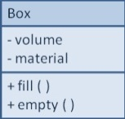
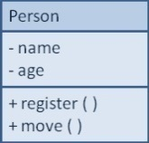
Structural Models
Main goal: to discover the key data contained in the problem domain and to build a structural model of the classes as solution.
Structural
Modeling
Solution Domain
Problem Domain

Slide 3
Class Diagram
A class diagram is a static model that shows the classes (both behaviors and states) and the relationships among classes that remain constant in the system over time.

Slide 4
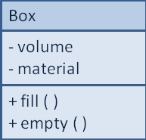
Classes, Attributes, & Operations
Classes
Templates for instances of people, places, or things in problem domain
Attributes
Properties that describe the state of an instance of a class (an object)
Operations
Actions or functions that a class can perform, i.e. behavior of an object, which later in design/implementation can be converted to methods
Only those attributes containing relevant information of the class are included. e.g. employee name vs. hair color.
All objects of a given class are identical in structure and behavior but contain different data in their attributes. E.g. 50 cubic meters paper box filled with documents vs. 20 cubic meters plastic box empted.

Slide 5
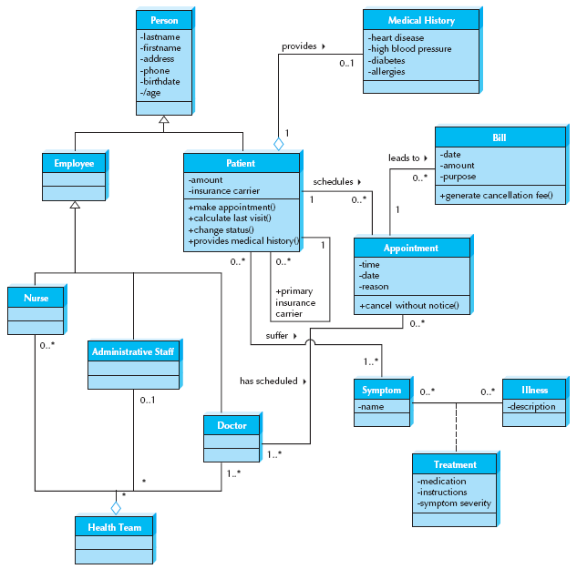
Figure 6-2 Sample Class Diagram
* Attributes and operations are omitted in some classes for simplicity.

Slide 6
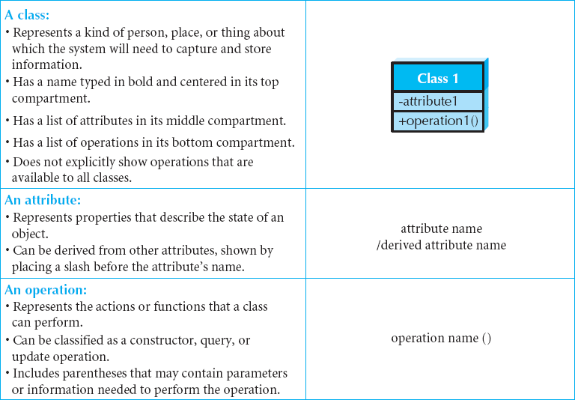
Elements of a Class Diagram
e.g. /age of a person in Figure 6-2 can be calculated from another attribute - birthdate.
Only those operations unique to the class are included, e.g. cancel without notice operation in the Appointment class, the generate cancellation fee operation in the Bill class in Figure 6-2.
Notes:
Later, during design and implementation, classes can refer to implementation-speciﬁc artifacts such as windows, forms, and other objects used to build the system.
The default visibility for an operation is normally public.

Slide 7
Attribute Visibility
Visibility relates to the level of information hiding to be enforced for the attribute, and can be specified in the class diagram
Public attributes (+) are visible to all external classes
Private attributes (-) are visible only to an instance of the class in which they are defined. Usually it’s the default visibility.
Protected attributes (#) are like private attributes, but are also visible to derived classes (subclasses)
Visibility helps restrict access to the attributes and thus ensure consistency and integrity

Slide 8
Operations
Constructor
Creates new object/instance
e.g., insert() to create new patient
Typically we do not see constructor methods (basic function) explicitly on the class diagram.
Query
Makes information about state available
e.g., calculate_last_visit()
a query method merely asks for information from attributes in the class (e.g., a patient’s name, address, phone), then it is not shown on the diagram
Update
Changes values of some or all attributes
E.g., change_patient_status(), schedule_appointment()

Slide 9
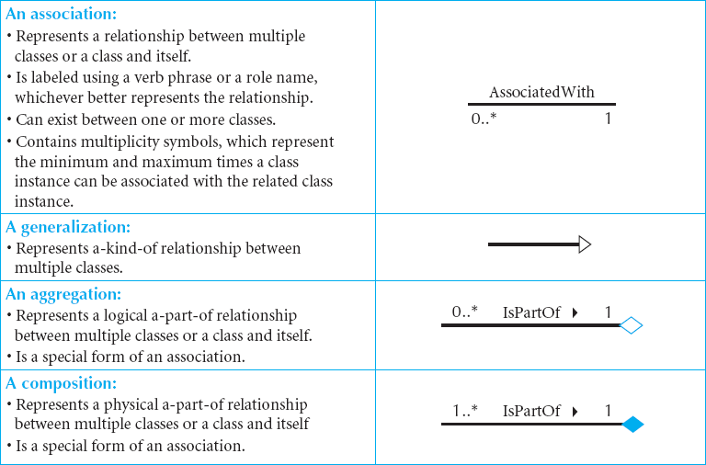
More Elements of Class Diagrams
E.g., The two classes patient and appointment are associated with one another whenever a patient schedules an appointment in Figure 6-2
Notes:
The relationship in diagram is shown as a line connecting two classes.
E.g., The two classes patient and appointment are associated with one another whenever a patient schedules an appointment in Figure 6-2. The triangle/arrow allows a direction to be associated with the name of the relationship. The relationship is to be read as patient schedules appointment. Adding a small arrow besides the name of the relationship increases readability. Sometimes a class is related to itself, as in the case of a patient being the primary insurance carrier for other patients (e.g., spouse, children) in Figure 6-2. A plus () sign is placed before the label to communicate that it is a role as opposed to the name of the relationship.

Slide 10
Multiplicity / Cardinality
Multiplicity/cardinality shows how an instance of an object is associated with instance(s) of another object.
Department
Boss
Exactly one:
A department has one and only one boss
1
1
Employee
Child
Zero or more:
An employee has zero to many children
1
0..*
Boss
Employee
One or more:
A boss is responsible for one or more employees
1
1..*
Notes:
in Figure 6-2, there is a 0..* on the appointment end of the patient schedules appointment relationship. This means that a patient can be associated with zero through many different appointments. (New patient may not have an appointment set yet, postponed or cancelled their first appointment.) At the patient end of this same relationship there is a 1, meaning that an appointment must be associated with one and only one (1) patient

Slide 11
Multiplicity / Cardinality
Employee
Spouse
Zero or one:
An employee can be married to 0 or 1 spouse
1
0..1
Employee
Vacation
Specified range:
An employee can take 2 to 4 vacations each year
1
2..4
Employee
Committee
Multiple disjoint ranges:
An employee can be in 1 to 3 or 5 committees
1
1..3, 5

Slide 12
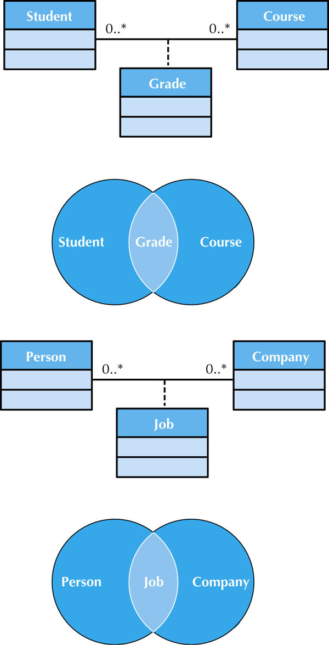
When two or more classes share a many-to-many relationship, a class called an association class is formed, which has its own attributes and operations.
It is shown as a rectangle attached by a dashed line to the association path, and the rectangle’s name matches the label of the association.
← Sample Association Classes

Slide 13
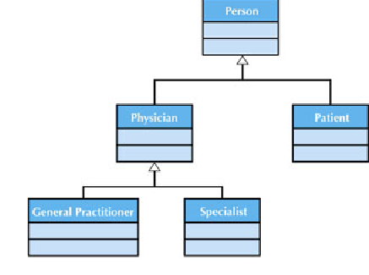
Sample Generalization Association
A Generalization Association (GA) shows that one class (subclass) inherits from another class (superclass), meaning that the properties and operations of the superclass are also valid for objects of the subclass.
GA is represented by a solid line from the subclass to the superclass and a hollow arrow pointing at the superclass. Use words like is a kind of.

Slide 14
Figure 6-2 Sample Class Diagram
Do you see any association class in this class diagram?
Notes:
e.g., An illness (e.g., the ﬂu) can be associated with many symptoms (e.g., sore throat, fever), and a symptom (e.g., sore throat) can be associated with many illnesses (e.g., the ﬂu, strep throat, the common cold). Figure 6-2 shows how an association class can capture information about remedies that change depending on the various combinations. For example, a sore throat caused by strep throat will require antibiotics; whereas, treatment for a sore throat from the ﬂu or a cold could be throat lozenges or hot tea.

Slide 15
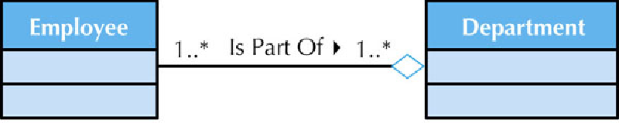
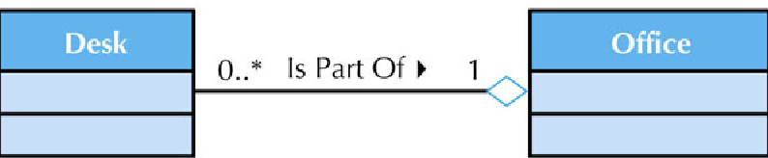
Sample Aggregation Associations
Aggregation represents logical parts to whole relationship
A white diamond is placed nearest the class representing the aggregation (health-care team),
Use words like is a part of or is made up of.

Slide 16
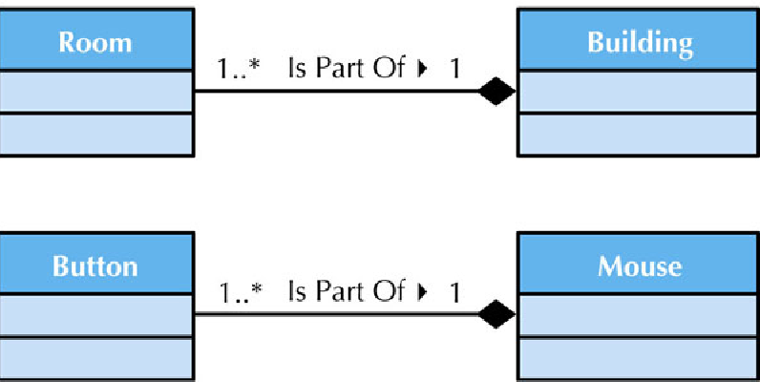
Sample Composition Associations
Composition represents physical parts to whole relationship
Notes:
A black diamond.

Slide 17
Concrete vs. Abstract Classes
Concrete
A concrete class is any class that is code complete and declares no abstract members. A concrete class can be a base class or a derived class and usually is used to create objects.
e.g., Employee, Customer, Product.
Abstract
An abstract class will always be a base class/superclass in a hierarchical relationship and require that other classes inherit from it. A pure abstract class has no implementation code, but only defines the method signatures that derived classes/subclasses are required to implement, also it may contain state variables. An abstract class may have one or more implementation/concrete class.
The software architecture will use a specialization of the pure abstract class called the interface among related classes when a common interface needs to be declared for interaction, but the actually implementation of the common interfaces will differ.
e.g., Person, Employee (abstract if there is a hourly or salary-based employee, concrete otherwise), Transaction (see example next slide).
Notes:
http://devmentor.org/references/uml/class_diagram.php

Slide 18
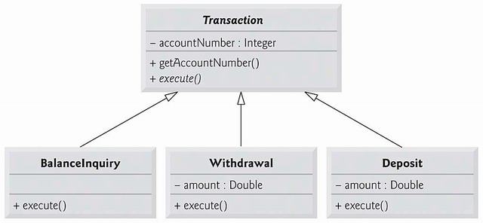
Concrete vs. Abstract Classes Example
Fro example, the Transaction hierarchy consists of the abstract class Transaction and three concrete subclasses (Withdrawal, Deposit, and BalanceInquiry).
The superclass Transaction has a constructor Transaction() which asks the customer to choose a transaction type and then constructs and returns an object of the appropriate subclass. Notice that generalization association (line with white arrow head point from subclass to superclass) is used.
The Transaction class is made responsible for getting the account number from customer, and it makes use of abstract method execute() which is implemented concretely by each subclass. Noticed that abstract class name Transaction and abstract method name execute() are italic in the class diagram.
More about class diagram in Chapter 9
Notes:
Example source:
http://www.math-cs.gordon.edu/courses/cps211/ATMExample2001/DetailedDesign.html
http://www.codeproject.com/Articles/34125/Chapter-10-Object-Oriented-Programming-Polymorphis

Slide 19
Relationships
Describe how classes relate to one another
Three basic types in UML
Generalization (flip side of specialization)
Enables inheritance of attributes and operations (a-kind of)
Encourages the analyst to focus on the properties that make each class unique by allowing the similarities to be factored into superclasses.
Employee (subclass) is a kind of Person (superclass), Secretary and Engineer (subclasses) each is a kind of Employee (superclass).
substitutability: the subclass should be capable of substituting for the superclass anywhere that uses the superclass. E.g. wherever employee class is used you should be able to replace it with engineer class.
Aggregation
Relates parts to wholes (a-part of)
e.g. a piston is a-part-of engine, an engine is a-part-of a car, Employee is a-part-of Department, or Department is a-part-of Organization, a Medical History is a-part-of Patient.
Association
Miscellaneous relationships between classes
whichever not applied to G or A. e.g. a patient schedules an appointment.

